Slide 1
Project Terra
Arbor Animalia

Slide 2
User Interface Final

Slide 3
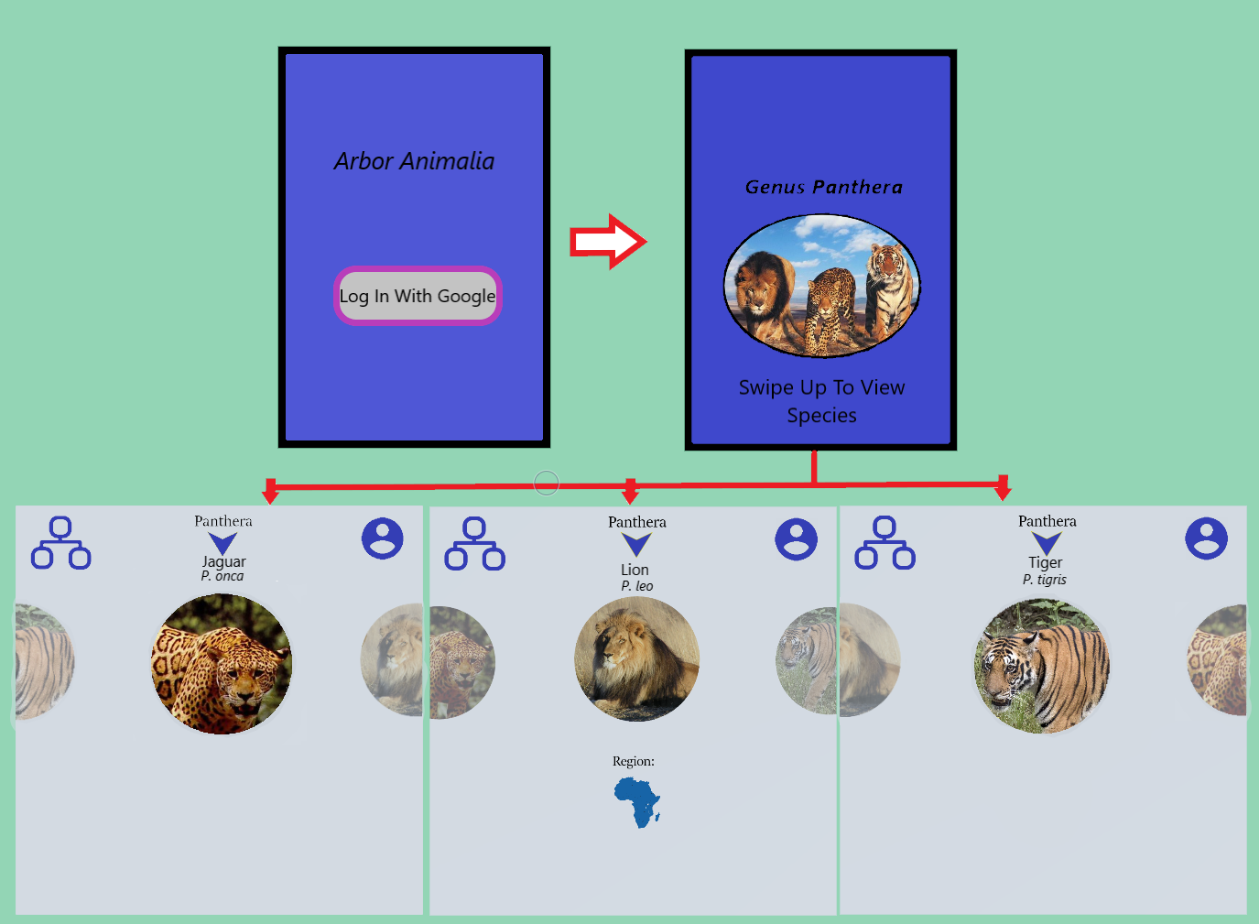
Interface Design

Slide 4
System Architecture

Slide 5
System Update
Alex for current updates to the system Infrastructure

Slide 6
Live Demo

Slide 7
Documents

